Slide 1
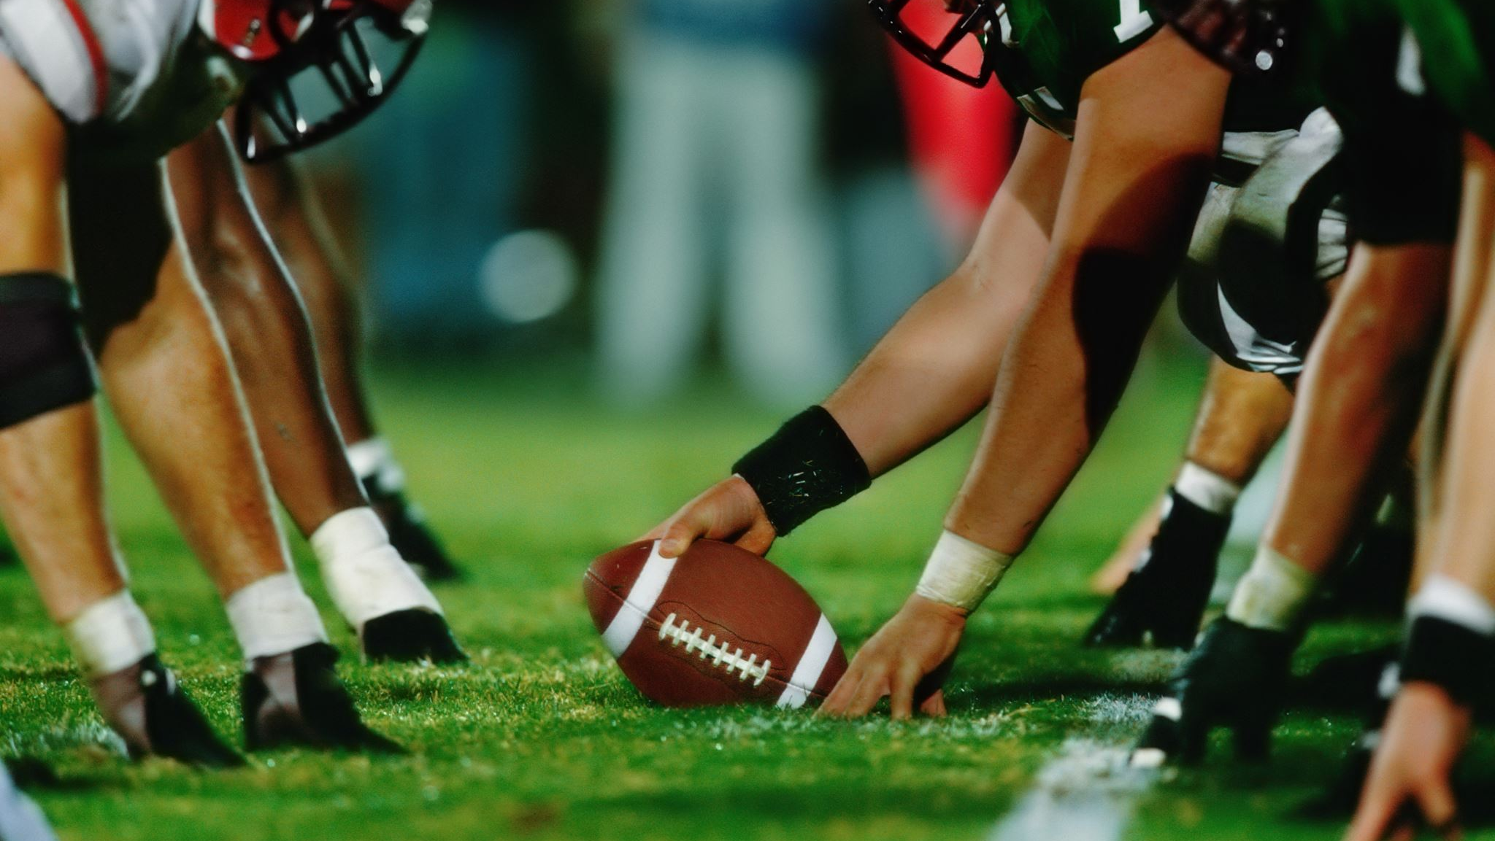
Concussions in the NFL
Carter Selway
Biostatistics
November 17, 2023

Slide 2
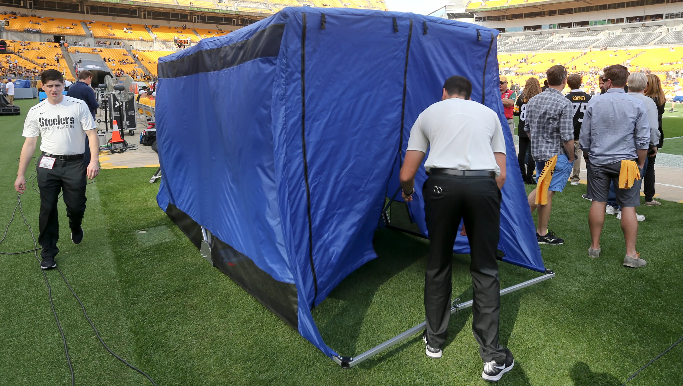
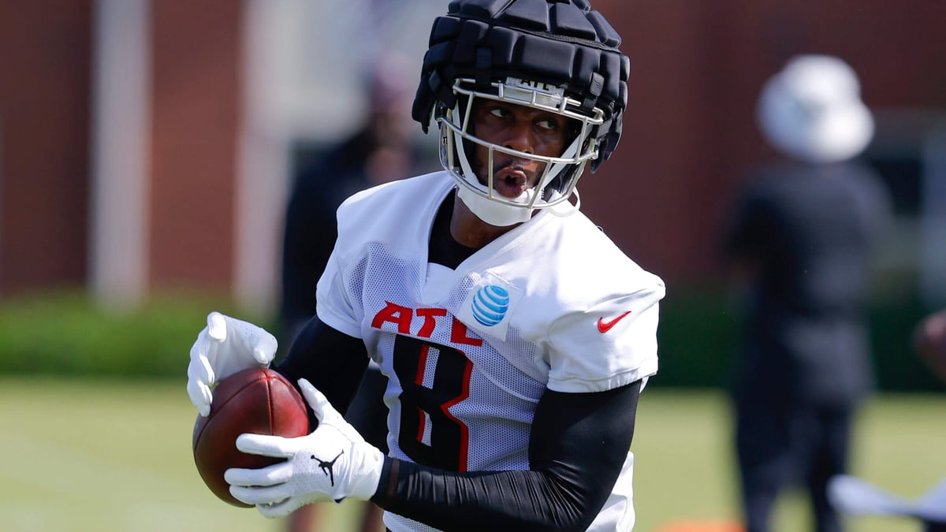
History of the NFL
For over a decade, the NFL has been criticized for their lack of care of their players.
The NFL has been sued by former players for the neurological damages they received. The NFL ended up paying roughly $765 million dollars for this lawsuit
The NFL responded by implementing new rules for the safety of the players, annual equipment safety inspections, and preseason safety gear.
Recently, the NFL required all players, who sustained a concussion, to go through protocol on the sidelines.

Slide 3
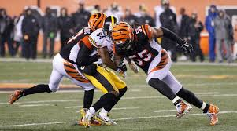
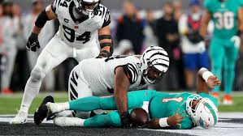
How did this happen?
A concussion occurs when one receives a blow to the head and causes the brain to move back and forth rapidly which causes the brain to bounce around or twist in the skull. Depending on the severity, chemical changes can occur that may damage brain cells
Prior to the new protocol rule, players would be allowed to return to the field after receiving a possible concussion and further risk the injury. This was either the player’s own decision or the coach sometimes especially in the regular season.
The incident of Tua Tagovailoa caused backfire on the NFL for its poor management of player safety.

Slide 4
Method
I gathered data from the NFL’s website on the number of concussions recorded in the regular season and compared it to the number of concussions recorded in the Preseason and Postseason combined.
The data will be conducted from the 2015 season all the way through the 2022 season. However, I will be excluding the 2020 season due to the Preseason being cancelled due to the Covid Pandemic.

Slide 5
Hypothesis
H₀: There is no difference in the total number of concussions sustained based on the season.
H_{a} : There is a significant difference in the total number of concussions sustained based on the season.

Slide 6
Pre and Post Season
Mean | 78
Standard Error | 6.41055677
Median | 81
Mode | 81
Standard Deviation | 16.960739
Sample Variance | 287.666667
Kurtosis | -0.9914518
Skewness | -0.6576705
Range | 44
Minimum | 53
Maximum | 97
Sum | 546
Count | 7
 | 1
t-Test: Paired Two Sample for Means
 | Pre and Post | Reg
Mean | 78 | 161.428571
Variance | 287.666667 | 588.285714
Observations | 7 | 7
Pearson Correlation | 0.61906063
Hypothesized Mean Difference | 0
df | 6
t Stat | -11.528062
P(T<=t) one-tail | 1.2805E-05
t Critical one-tail | 1.94318028
P(T<=t) two-tail | 2.5609E-05
t Critical two-tail | 2.44691185
Regular Season
Mean | 161.428571
Standard Error | 9.16737783
Median | 161
Mode | 135
Standard Deviation | 24.2546019
Sample Variance | 588.285714
Kurtosis | -1.8927973
Skewness | 0.19172521
Range | 57
Minimum | 135
Maximum | 192
Sum | 1130
Count | 7
 | 1
Result:
T stat>T crit & P value < 0.05; therefore, we reject the null hypothesis

Slide 8
(2015: 289); (2016: 255); (2017: 284); (2018: 216); (2019: 226); (2021: 192); (2022: 214)

Slide 10
Conclusion / Discussion
Concussions were shown to occur more frequently in the regular season compared to the Postseason and Preseason combined. Factors such as more caution in the Preseason and Postseason and the ambition of the organizations in the regular season to reach the playoffs attribute to this cause.
Though we see a decrease in total concussions, we started seeing a rise in the regular season concussions in the 2022 season by 18%. But why?
Data taken from NIH showed that from 1996-2007 a total of 1545 concussions were reported whereas with my data in only an eight-year span, 1462 concussions were reported.
Even with modern technology and safer equipment, we continue see an increasing number of concussions, especially in the regular season. So, moving forward, the NFL needs to invest in the protection of its players and to determine the common denominator of this issue and find a resolution for it.

Slide 11
References
“Official Site of the National Football League.” NFL.Com, www.nfl.com/injuries/league/2022/REG4.
Nfl. “Injury Data since 2015.” NFL.Com, NFL, 17 Oct. 2023, www.nfl.com/playerhealthandsafety/health-and-wellness/injury-data/injury-data.
Casson, Ira R, et al. “Twelve Years of National Football League Concussion Data.” Sports Health, U.S. National Library of Medicine, Nov. 2010, www.ncbi.nlm.nih.gov/pmc/articles/PMC3438866/.

Slide 12
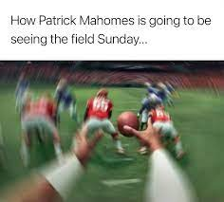
The End

